Slide 1
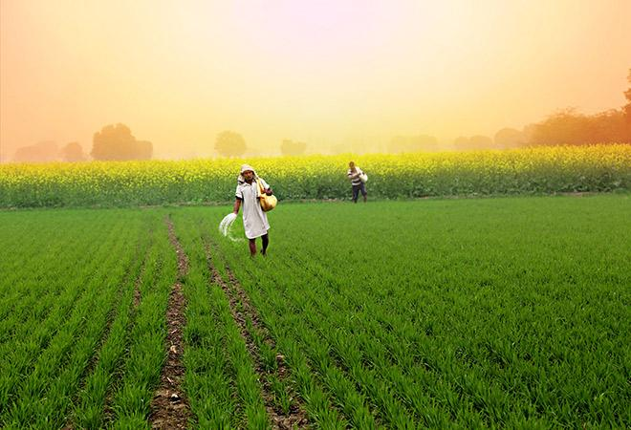
RC FarmBot

Slide 2
Problem statement
Farmers face challenges in effective monitoring the soil conditions across their fields, including soil moisture, temperature, and humidity. Existing methods often involve manual labor and are time-consuming, leading to suboptimal resource allocation and potentially reduced crop yields. Therefore, there is a need for an automated solution that can traverse the farm, collect accurate and real-time data on soil moisture, temperature, humidity and provide actionable insights for farmers so they can take accurate decision on watering etc..

Slide 3
Solution
The RC FarmBot is a specially designed vehicle that can navigate through farm terrain easily. It is equipped with robust wheels and suspension to handle various surfaces and weather conditions.
The integrated sensors measures the soil moisture, temperature and humidity content accurately. This data is crucial for farmers to understand the environmental conditions affecting their crops and make informed decisions accordingly.

Slide 4
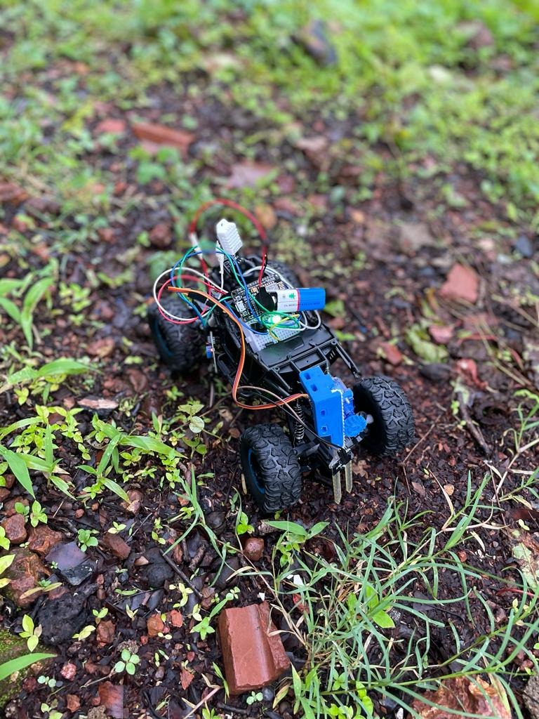

Slide 5
Benefits
Increased Efficiency:
Eliminates the need for manual soil measurements, saving time and labor.
Enables data collection from multiple points in the field simultaneously.
Enhanced Crop Health:
Provides real-time insights into soil moisture, temperature, and humidity.
Enables timely irrigation adjustments and prevents over/under-watering.
Improved Yield:
Optimizes crop growth conditions based on accurate data.
Reduces the risk of crop damage and loss due to adverse soil conditions.

Slide 6
Competitive advantage
Combination of Soil moisture and DHT (Temperature and Humidity) sensors in a single device.
Easy-to-use remote control for precise navigation.
Robust construction for farm environments.
Real-time data collection and analysis for informed decision-making.

Slide 7
Conclusion
RC FarmBot solution combines the convenience of remote control with the functionality of moisture and DHT sensors to enable accurate soil temperature and humidity monitoring on farms. It empowers farmers with timely information to make informed decisions, leading to improved crop health and increased yield.
By adopting RC FarmBot, farmers can revolutionize their farming practices, optimize their yields, and contribute to a more sustainable and efficient agriculture industry. Together, let's embrace the power of technology to shape the future of Agriculture.

